Slide 1
REDUCE overhead and cost
Infrastructure
Licenses
Operations

Slide 2
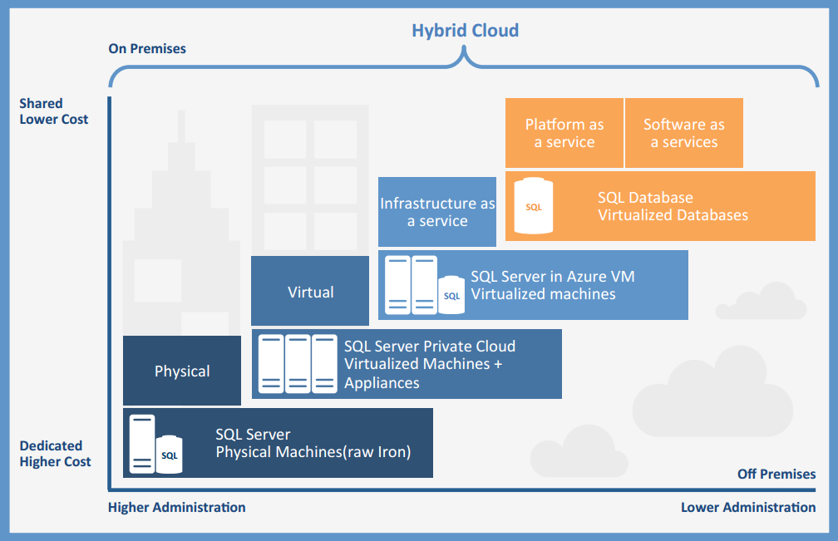
A modern target environment

Slide 3
Target environment Our vision for a modern data platform hosting SQL services
Private cloud
Public cloud
On Premises
Infrastructure
(as a Service)
Platform
(as a Service)
Applications
Applications
You manage
Applications
Data
Data
Data
You manage
Runtime
Runtime
Runtime
Middleware
Middleware
Middleware
You manage
Managed by Microsoft
O/S
O/S
O/S
Virtualization
Virtualization
Managed by Microsoft
Virtualization
Servers
Servers
Servers
Storage
Storage
Storage
Networking
Networking
Networking

Slide 4
On-premise, hybrid cloud
Cost reduction is achieved through
New Infrastructure
1:1 migration from old hardware to new isolated servers
More memory, up to 2TB improves database density per instance
Fewer licenses
By reducing total number CPU/cores, and improve total utilization.
Right balance, Standar vs. Enterprise edition*.
Smarter operations
Reduction of servers, instances and complexity.
Lowering cost on storage by utilizing cloud services (Backup / Recovery, Stretch database, Azure blob storage).
Our choice for
Applications with specific requirements to
High Performance
High Availability
*Legal Security
Corporate core data
Applications
Data
Runtime
Middleware
You manage
O/S
Virtualization
Servers
Storage
Networking
Notes:
*With the release of SQL Server 2016 SP1, many Enterprise features are now available in Standard, Web, and Express: https://www.microsoft.com/en-us/sql-server/sql-server-editions
*With new Azure datacenters in Germany under German law, legal security is becoming a less issue

Slide 5
Infrastructure (as a Service)
Cost reduction is achieved through
No investment in new hardware
Lower license cost through increased flexibility
No investment in own licenses, or repurpose existing licenses
Pay by the minute, hour, day or month as needed
Adapt capacity/price dynamically as needed
Adjust availability as needed
Smarter operations
Simplified patching, backup, and high availability through automation
Our choice for
Applications with specific requirements to
Isolation (3rd party applications with special requirements to Isolation)
Legacy (Parking of old systems which cannot be modernized/upgraded
Evaluation of new systems (purchases)
Applications
Data
You manage
Runtime
Middleware
O/S
Virtualization
Managed by Microsoft
Servers
Storage
Networking

Slide 6
Platform (as a Service)
Cost reduction is achieved through
No investment in new hardware
No investment in new licenses
Reduced operations
No maintenance of hardware, operating systems, database software or databases*
Our choice for
Existing applications with less stringent requirements for performance
Existing applications with less stringent requirements for storage
Test and development
New applications created for the cloud
You manage
Applications
Data
Runtime
Middleware
Managed by Microsoft
O/S
Virtualization
Servers
Storage
Networking
Notes:
*Application logic is still maintained by you, also in a situation when a restore would be neccecary because of a logical error this will have to be triggered manually.

Slide 7
On-premise
Secure SQL platform for future growth and functionality through Windows 2016 and SQL Server 2016 SP1
Remove all older version, focusing only on SQL Server 2016
Incorporate Microsoft cloud as a foundation of a future platform
Consolidate legacy or non-migratable versions in an isolated environment
O
On-premise
2016
2000
2005
Azure
2008
2016
2008 R2
v12
2012
On-premise legacy
2014
2000
2005
2008
2008 R2
2012
2014

Slide 8
Additional benefits
On Premises
Cloud
Increased availability is achieved through
Windows server 2016
Cluster Operating System Rolling Upgrade
Cloud Witness
Multi-domain clusters
Virtual Machine Load Balancing
Virtual Machine Start Order
Native container support (Docker)
SQL server 2016
AlwaysOn Failover Clustering (FCI)
AlwaysOn Availability Groups (AG)
Increased performance is achieved by
Support för upp till 24TB internminne
64 sockets, ingen begränsning på antalet kärnor
Other
Always-Encrypted
Increased availability is achieved through
Infrastructure (as a Service)
Microsoft out-of-box availability SLA of 99.95%*
AlwaysOn Failover Clustering (FCI)
AlwaysOn Availability Groups (AG)
Platform (as a Service)
Microsoft out-of-box availability SLA of 99.99%
Two local replica databases, for every primary database
Geo-Restore
Geo-Replication
Increased performance is achieved by
Tillpassa kapacitet efter behov
Other
Audeting
Kryptering
Monitorering
Advisory recommendations
Notes:
*Higher availibillity is possible though additional features

